Slide 1
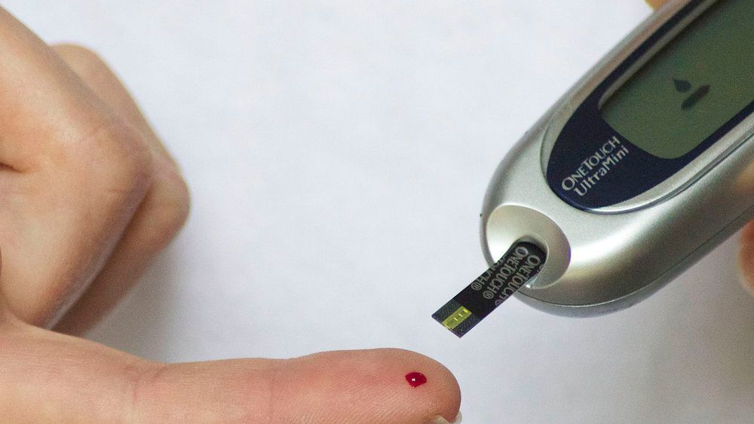
Website for detection of​
diabetes using machine learning
​ ​Bio-Informatics department
​​
Supervised by: ​
​
​
Dr. Alaa Allakany ​​
Professor of information systems​​
Information systems department​​
Faculty of computer and information​​
Kafr el-Sheikh University​​

Slide 2

TEAM MEMBERS
1- Moataz Mohamed
2- Mahmoud Salah
3- Abd ElAziz Aoun
4- Bassant Adel
5- Mirna Mahmoud
6- Gehad Mahmoud
7- Noha AbdulHawahab
8- Haidy Sobhi

Slide 3

AGENDA
1.Introduction..............................................4
2.Problem....................................................5
3.Proposed framework.................................6
.4.Results...................................................11
5.Conclusion..............................................12
6.Future work............................................13
7.Reference...............................................14

Slide 4
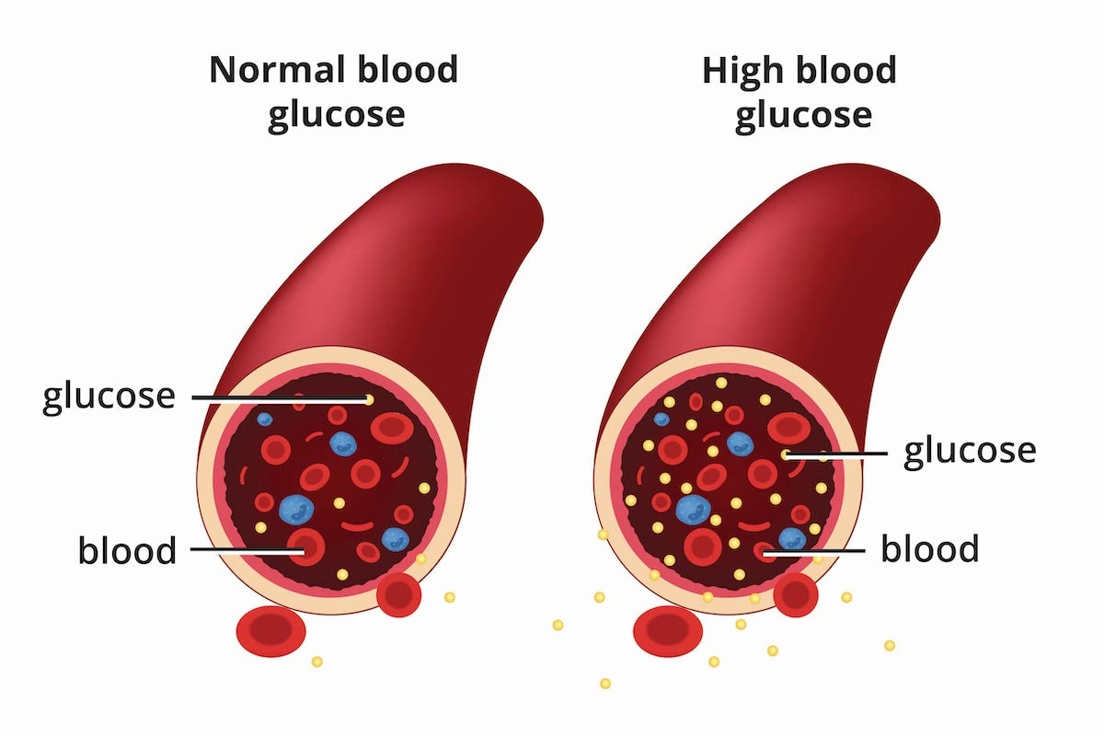
INTRODUCTION
What is the diabetes?
Diabetes is a disease that occurs when your blood glucose, also called blood sugar, is too high. Glucose is your body’s main source of energy. Your body can make glucose, but glucose also comes from the food you eat.
Types of Diabetes?
Type 1
Type 2
What factors predict diabetes?
the disease is predicted by many factors, including family history, lifestyle locations, medical stimulus for blood, body levels, body index (BMI), and blood pressure.

Slide 5
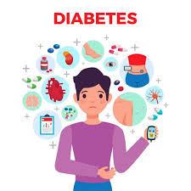
PROBLEM
Reasons of establishing project
1.The number of people with diabetes increases annually
2.Late discovery leads to serious complications
3.Life style is one of the causes of disease and increase the risk
4. Lifelong Medication

Slide 6
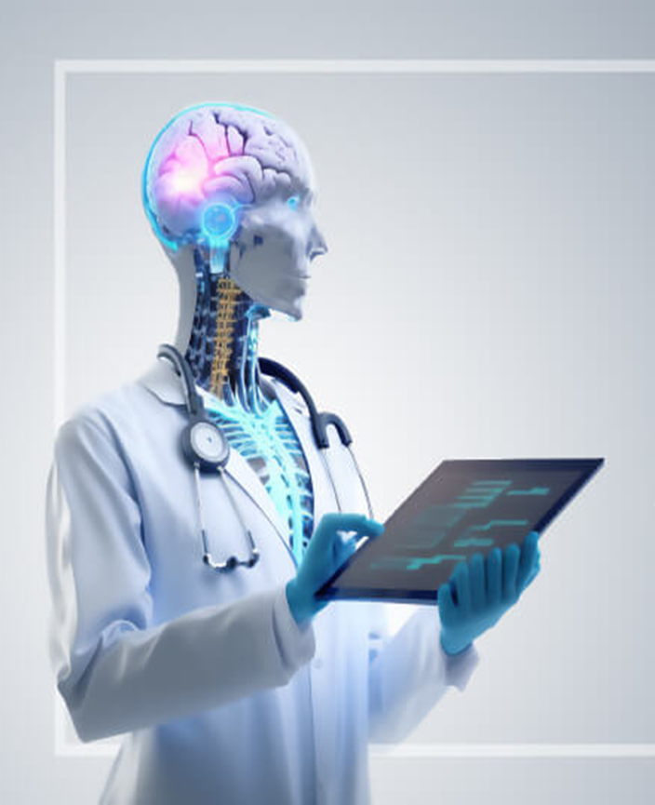
PROPOSED FRAMEWORK
-ML Model
1.Pre-processing phase.
2.Classification phase.
3.Evaluation phase.
-Website
1.front end
2.back end

Slide 7
Pre-proessing phase
-Cleaning the date set
Remove null
Handling missing values

Slide 8
Classification Phase
-We split the used datasets into two subsets: training and testing data, 80% to training and 20% is to testing (will be discussed in the evaluation phase).
- We investigated six ML classifiers: (DT, Gradient Boosting, KNN, Random forest,MLP and Logistic Regression) are applied to predict the accuracy based on the selected optimal features. Where the gradient boost and DT achieved the highest accuracy leading us to choose them for the hyper parameter to reach highest accuracy.

Slide 9

EVALUATION PHASE
​
It is examined based on the test data (20% of the original dataset) provided using the hold-out method for both datasets​.

Slide 10
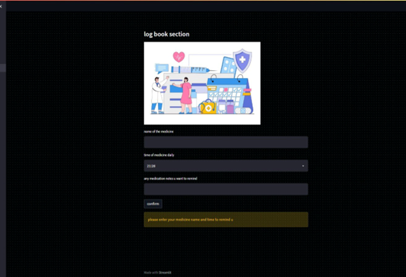
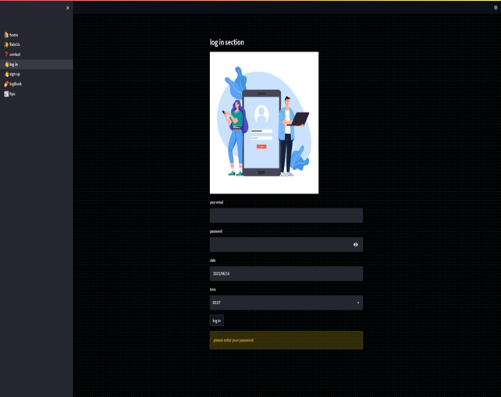
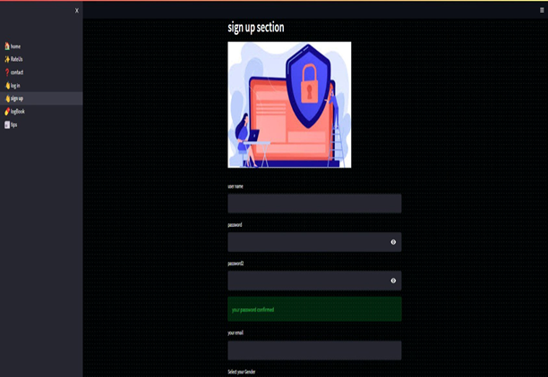
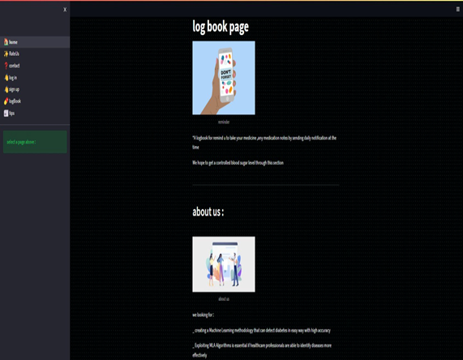
Front End

Slide 11
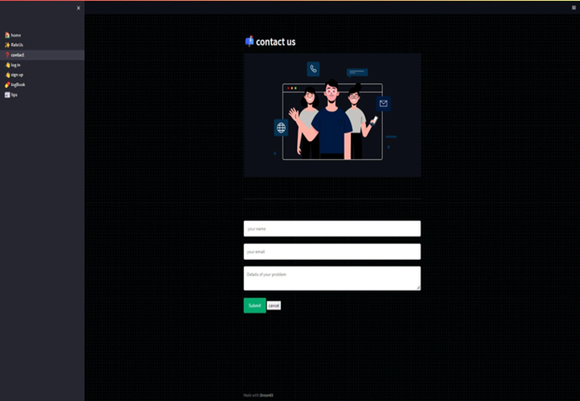

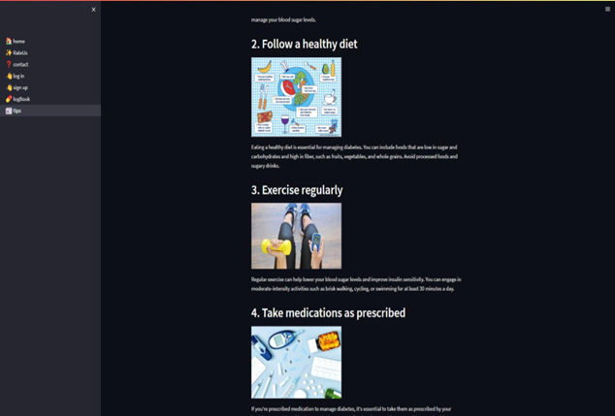
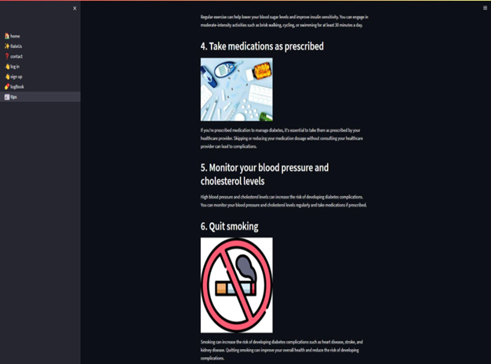
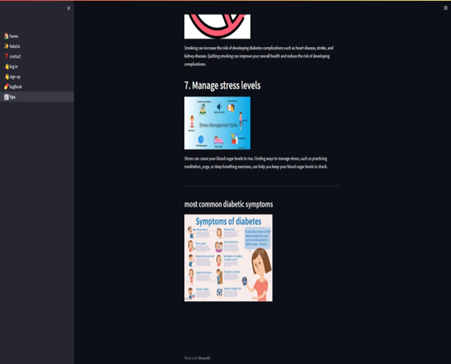
Back End
Database(SQL which offers a lightweight and embedded database solution) .

Slide 12
Before hyper parameter
-Logistic Regression Model=75%
-MLP classifier accuracy = 69%
-RF classifier accuracy = 68%
-KNN classifier accuracy = 70%
-DT classifier accuracy = 78%
-Gradient Boosting Model=80%
After hyper parameter
-DT classifier accuracy = 89%
-Gradient Boosting classifier accuracy = 90%
RESULTS

Slide 13
Finally, the aim of our project is to find out if a person has diabetes or not by doing the website of machine learning and through some algorithms and statistics where we were able to deliver the accuracy of the project to 90% and through the success and adoption of this project we can apply it to other diseases.
CONCLUSION

Slide 14
1- Improve the accuracy.
2- devolp amobile application.
3- Using deep learning model.
4- Detection depend on DNA sequence and Retina.
FUTURE WORK

Slide 15
https://github.com/SridharCR/Diabetes_Prediction
ttps://www.researchgate.net/publication/340700070_Prediction_of_Type_2_Diabetes_using_Machine_Learning_Classification_Methods
REFERENCE

Slide 16
Thank you

